Slide 1
ORDER PROCESSING
Information SYSTEM
IF-36-03

Slide 2
Description
"Order processing" is the term generally used to describe the process or the work flow associated with the picking, packing and delivery of the packed item(s) to a shipping carrier. [1]
Order processing is the core element of Order Fulfillment. Their operations or facilities are commonly called “Distribution Centers”
There is no “one size fits all” process that universally provides the most efficient operation. [2] For example, shipping eggs and shipping shirts have a different order processing.

Slide 3
Why order processing
Because Order Processing is one of the most common and important Information System, especially in a Company which moves in sales and marketing industries .
Because each Order processing flow have it’s own unique requirements and priorities depending on many factors, so that Order Processing can have so many possibilities with different approach and different efficiency.
Because specifically in Indonesia, the use of Information system based on Order processing is increasing drastically.

Slide 4
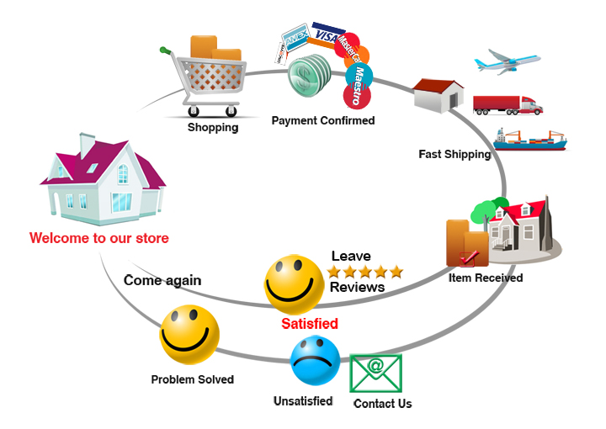
ORDER processing Flow
Example :
(Sales and Procurement
Order Processing Flow)
Source : http://www.sainsonic.com/media/wysiwyg/policy-photo/Procedure.jpg

Slide 5
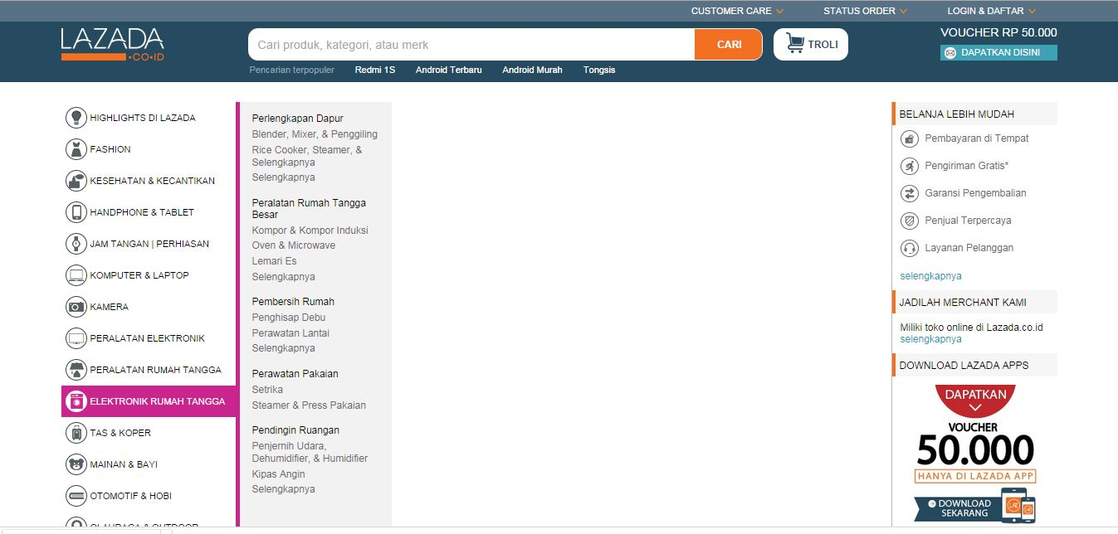
ExAMPle
Lazada Online Shopping
Source : www.lazada.com

Slide 6
Manual vs online
For client
User | Manual | Online
Client | Onsite | Online
 | Payments needs to be in-person | Payments using Bank Accounts or other alternatives
 | Choosing items is particularly hard and tiring | The use of online catalogue and categorization makes choosing an item easier
Pemilik | Customer limited to a particular area | Customer area is a lot wider
 | Stock items is updated manually | Stock items is updated automatically by the system

Slide 7
THE IDEA OF OUR PROJECT
Creating an Information System for an Online Shop that sells apparel
Order Flow :
Catalogue
Login
Order
System
Payment
Payment Validation
Shipping
Received

Slide 8
WhY ?
Because online shop is far more popular on Teenage Consumer. And usually, what they’re trying to find in Online shop is related to fashion and apparel.

Slide 9
LIMITATION OF PROBLEM
Items database is updated automatically by the system when the customer choosing an order
The System doesn’t process discount and shipment fee
No limit on minimum order
No limit on booking an item

Slide 10
Data flow diagram
Level 0
Client
username, pass, view, payment, order
System
products_sent,
err_msg
update, payment_validation
Admin

Slide 11
DFD LEVEL 1
view
Client
order, payment
Catalogue
username, pass
Login
err_msg
login_valid
update
Error
login_error
Ordering
products
sent
payment_not_
valid
receipt_of_payment
Shipping
Validation
payment_validation
payment_valid
Admin

Slide 12
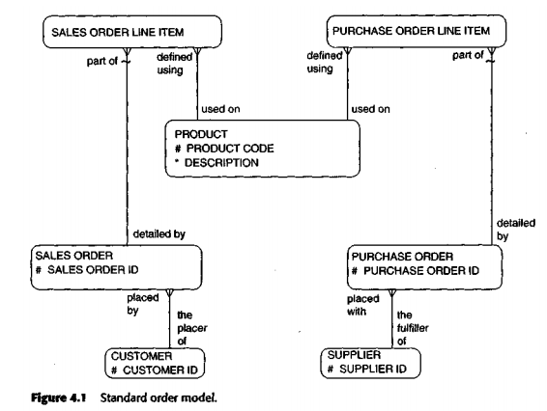
Standard Order Model
Order terbagi menjadi dua jenis :
Supplier akan berhubungan dengan Purchase Order
Customer akan berhubungan dengan Sales Order

Slide 13
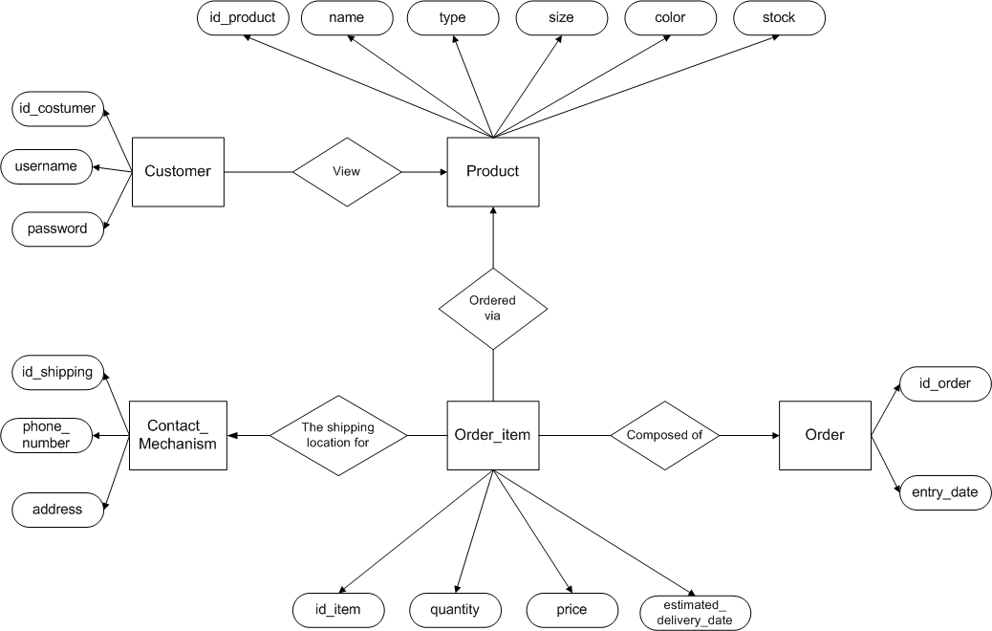
Er diagram

Slide 14
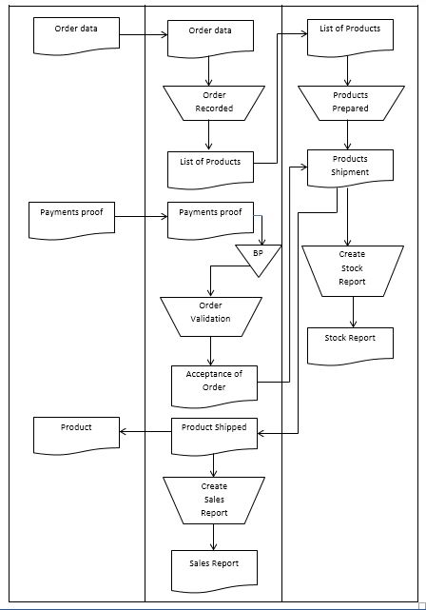
FLOW MAP

Slide 15
References
[1] & [2] : http://www.britannica.com/EBchecked/topic/431437/order-processing

